Slide 1
PSMS Football Summer Workouts
Good Luck. Please email schubekx@pwcs.edu if you have any questions.

Slide 2
Push-Up Strength Test and Workout
Test-(Proper Push-up form- Feet together, legs straight and off of the ground, back straight, hands a little more than shoulder with and at your chest, head staring at the ground)
Starting in the up position (Legs and back straight) Go down without your legs touching the ground. Down and up count as 1.
Test- Perform as many perfect push-ups in a row without stopping. Put that number in the chart on the next slide.
Repeat this once a week. Log in your results on the chart.

Slide 3
Push-up Test Results
Week | Date | Number of Push-ups
1 | S-July 3
2 | S-July 10
3 | S-July 17
4 | S-July 24
5 | S-July 31
6 | S-August 7
7 | S-August 14

Slide 4
Push-Up Daily Workout
After your first push-up test:
Calculate your number of push-ups per day
Multiply your test result by 2 to find your goal for the day.
If that number is below the daily minimum then do the minimum.
Ex Test result 10 push-ups x 2 = 20. Do the min.
Ex Test result is 31 push-ups x 2= 62
The minimum pushups for each person
Each new week may change your goal
Week | Minimum Push-ups each day
1 | 50
2 | 60
3 | 70
4 | 75
5 | 85
6 | 95
7 | 100

Slide 5
Push-up daily workout cont.
The daily push-up workout minimum is a DAILY Goal.
You can do 1 push-up 50 times throughout the day, or 2 push-ups 25 times throughout the day, or any combination until you reach your goal.
Tips
Keep a log of how many you do
Set timers for each 30 mins or 60 mins

Slide 6
Workout Schedule
Sunday | Monday | Tuesday | Wednesday | Thursday | Friday | Saturday
Pushups | Pushups | Pushups | Pushups | Pushups | Pushups | Pushups
Rest | Conditioning 1 | Agility 1 | Rest | Agility 2 | Conditioning 2 | Rest

Slide 7
Conditioning Workout 1
Warmup-10 yards each(1 way):
High Knees, Butt Kicks, Frankensteins, Lunge Twists, Shuffle Left, Shuffle Right, Carioca, High Skips, 2 Sprints
Exercise | Explanation | Duration and Rest
1 Burpees | Stand, sprawl 2 push-ups, explode up hands trying to block a pass | 30 secs/30 secs
2 High, Medium, Low Punches | Start with right foot forward. Punch above your head R,L. Punch at your Chin R,L. Punch at your Stomach R,L. SWITCH Feet repeat | 30 secs/30 secs
3 Front Kicks | Start with Left foot forward. Kick your R foot straight ahead as high and as hard as you can. Reset, repeat for 5 kicks, switch feet and repeat | 30 secs/30 secs
4 Shuffle Shuttle | Stay Low Shuffle Right 3 times and touch the ground with your right hand. Shuffle Left 3 times and touch the ground with left hand. Repeat. | 30 secs/30 secs
5 Knee-ups | Start with your hands up, Jump up with both knees and bring them as high as you can to your chest. Stay tall. | 30 secs/30 secs
6 Jumping Jacks | Keep Arms straight at sides and clap them together over your head. | 30 secs/30 secs
7 Running in place | Quick hands and feet | 30 secs/30 secs
8 Jumping lunges | Start with your right foot forward, lunge halfway, jump up switch legs and land in a halfway lunge. Repeat. | 30 secs/30 secs
9 Rest | Rest for 1 minute. Repeat the 8 exercises. 2 sets total.

Slide 8
Conditioning Workout 2
Warmup-10 yards each(1 way):
High Knees, Butt Kicks, Frankensteins, Lunge Twists, Shuffle Left, Shuffle Right, Carioca, High Skips, 2 Sprints
Jog walks. Jog for 30 seconds then walk for 20sec/ 2 times
Sprint jogs-Sprint for 5 seconds then jog for 20sec/5 times
10-10 yard sprints. Walk back then sprint. 20 seconds between sprints
10-20 yard sprints. Walk back then sprint. 20 seconds between sprints
5-40 yard Sprints. Walk back then sprint. 30 seconds between sprints
Rest for 3 minutes
30 yard shuttle runs. Run 30 yards touch the ground, return to start and touch the ground. Down and back 2 times. Do 3 total shuttle runs.

Slide 9
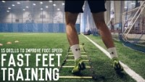
Agility workout 1 Warmup-10 yards each(1 way): High Knees, Butt Kicks, Frankensteins, Lunge Twists, Shuffle Left, Shuffle Right, Carioca, High Skips, 2 Sprints Speed ladder workout- you can draw one with chalk
Watch the video and do each exercise twice.

Slide 10
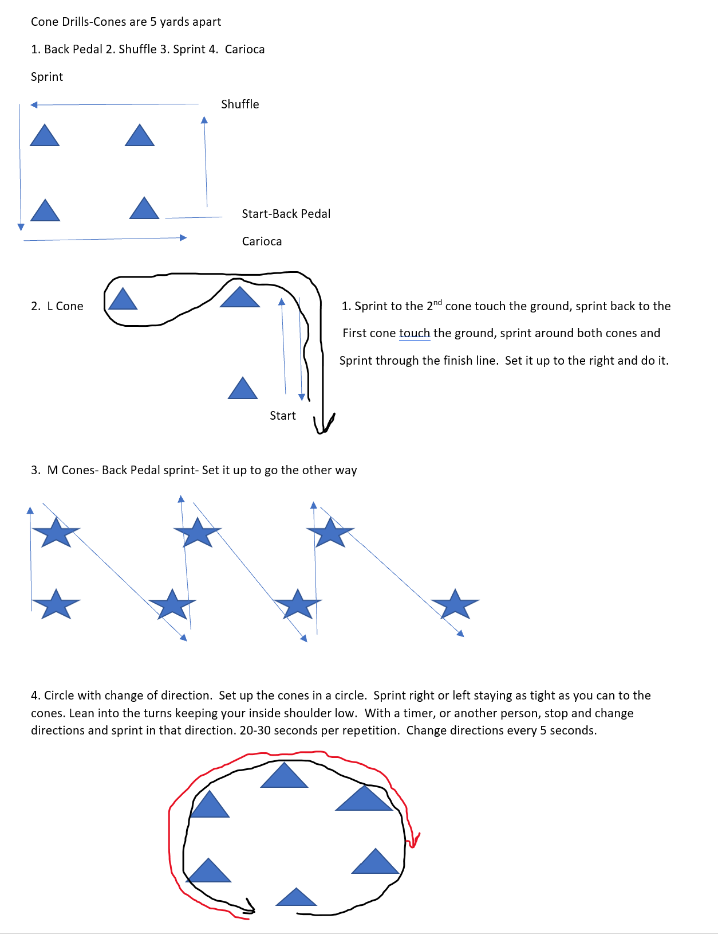
Agility 2 Cone Drills.docx (Click on the link)

